Slide 1

C++
Memory management

Slide 2
Table of contents Index / Agenda
The Stack and The Heap
Pointers
Dynamic memory in C
Dynamic memory in C++
References
Author

Slide 3
The stack and the heap
Memory areas
The memory a program uses is typically divided into four areas:
The code area, where the compiled program sits in memory.
The global area, where global variables are stored.
The heap, where dynamically allocated variables are allocated from.
The stack, where parameters and local variables are allocated from.

Slide 4
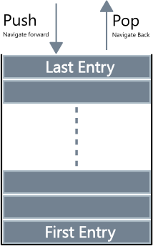
The stack and the heap
The stack
Is a LIFO ( Last In First Out) data structure.
The function call stack uses the function call/return mechanism.
It's a special region of your computer's memory that stores temporary variables created by each function (including the main() function).
The stack has a limited size (OS - dependent).
Provides very fast access (it only modifies the value of the stack pointer).
At each function call a stack frame is created that contains the function local variables and the return address.

Slide 5
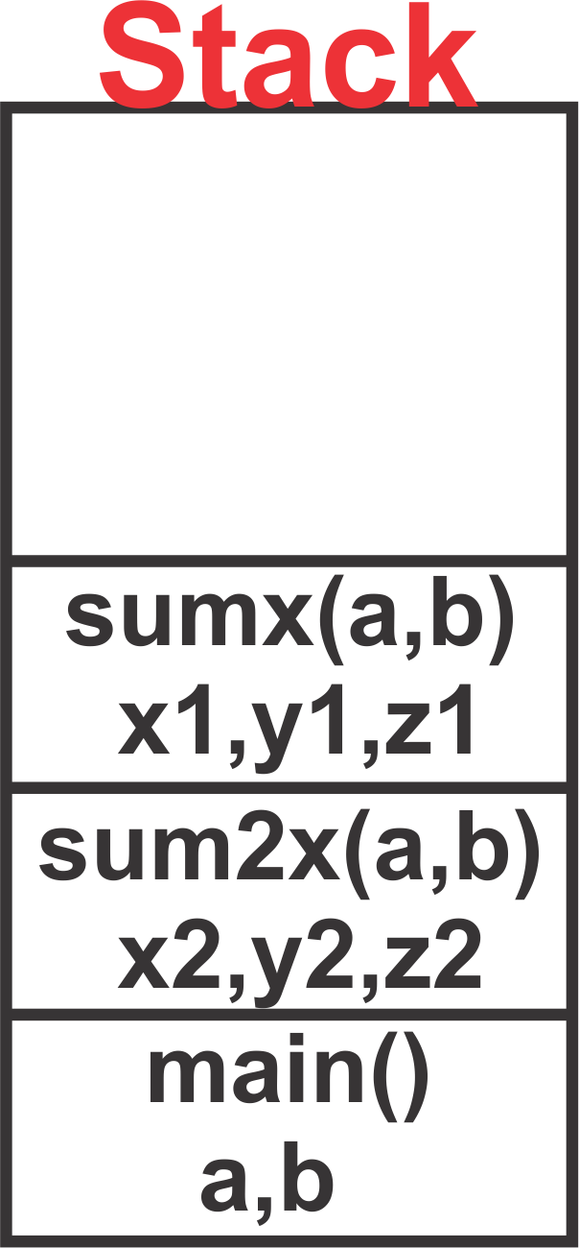
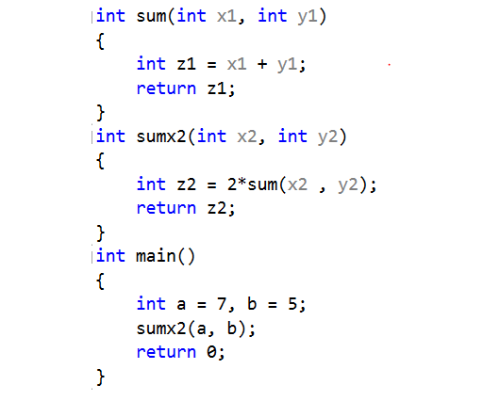
The stack and the heap
The stack

Slide 6
The stack and the heap
The heap
Large pool of memory used for dynamically allocation.
The access speed is slower compared to the stack access speed.
The precise location of the memory allocated is not known in advance, the memory allocated has to be accessed indirectly through pointers.
Memory may become fragmented over time as blocks of memory are allocated, then freed.

Slide 7
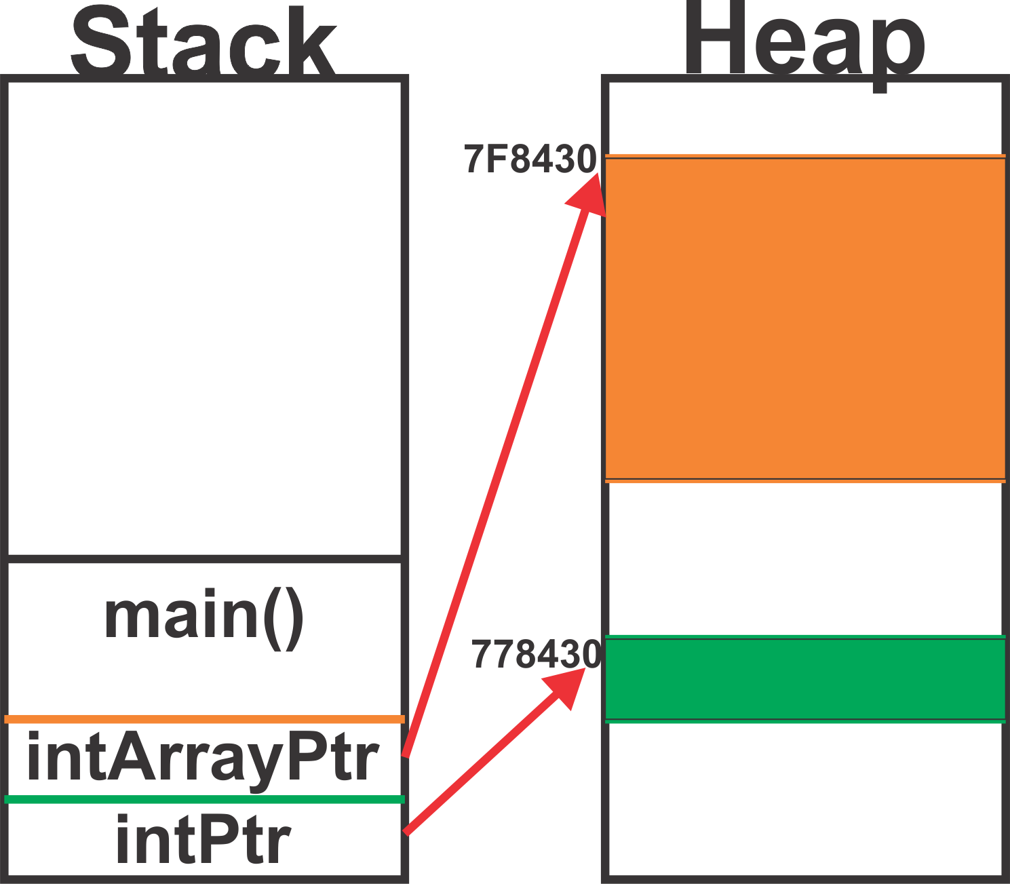
The stack and the heap
The heap
int main()
{
// Allocate space on heap for int value
int* intPtr = new int;
// Allocate space on heap for int array
int* pIntArray = new int[4];
// . . .
return 0;
}

Slide 8
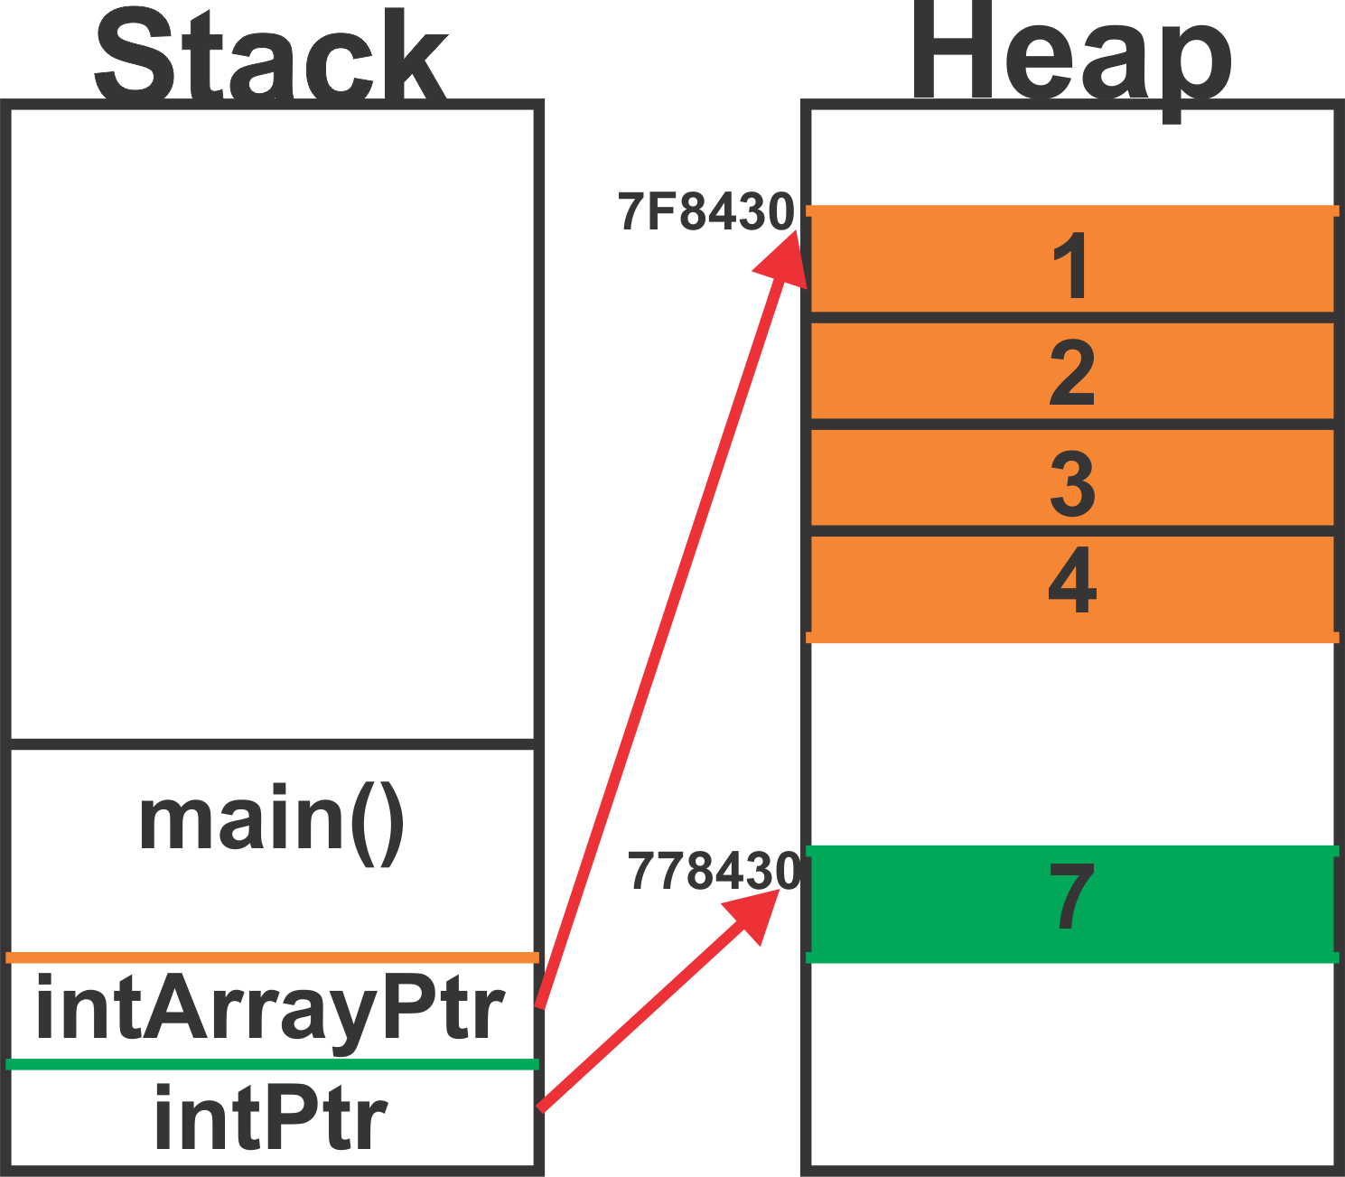
The stack and the heap
The heap
// . . .
// Assign 7 to the integer
*intPtr = 7;
// Initialize the array
for (int i = 0; i < 4; ++i)
{
pIntArray[i] = i + 1;
}
// . . .

Slide 9
Pointers
Memory structure:
The memory can be imagined as a succession of memory cells, each one of the minimal size that computers manage (one byte).
The memory cells are numbered in a consecutive way, so as, within any block of memory, every cell has the same number as the previous one plus one.
The memory addresses are represented in hexadecimal

Slide 10
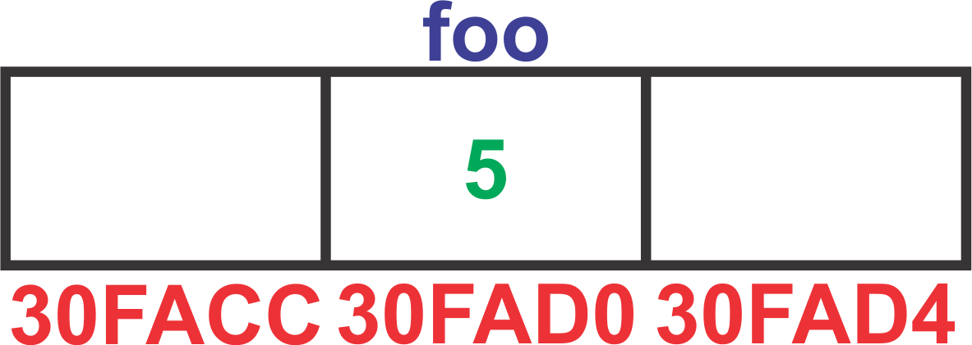
Pointers
Address-of operator (&) – returns the memory address of the variable
int main()
{
int foo = 5;
// & operator returns the memory location
// of the variable it points to
std::cout << &foo
return 0;
}

Slide 11
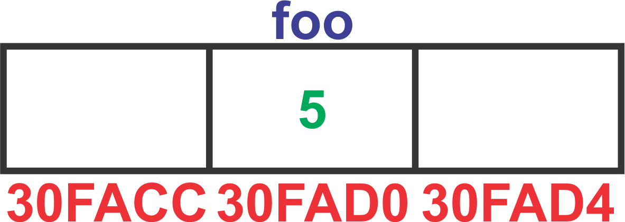
Pointers
Pointer - a variable whose value is the address of another variable
using namespace std;
int main()
{
int foo = 5;
// Declare a pointer to an integer
int *ptrFoo;
// Initialize pointer
ptrFoo = &foo; // store the address of Foo
cout << *ptrFoo; // get value from address: 5
return 0;
}

Slide 12
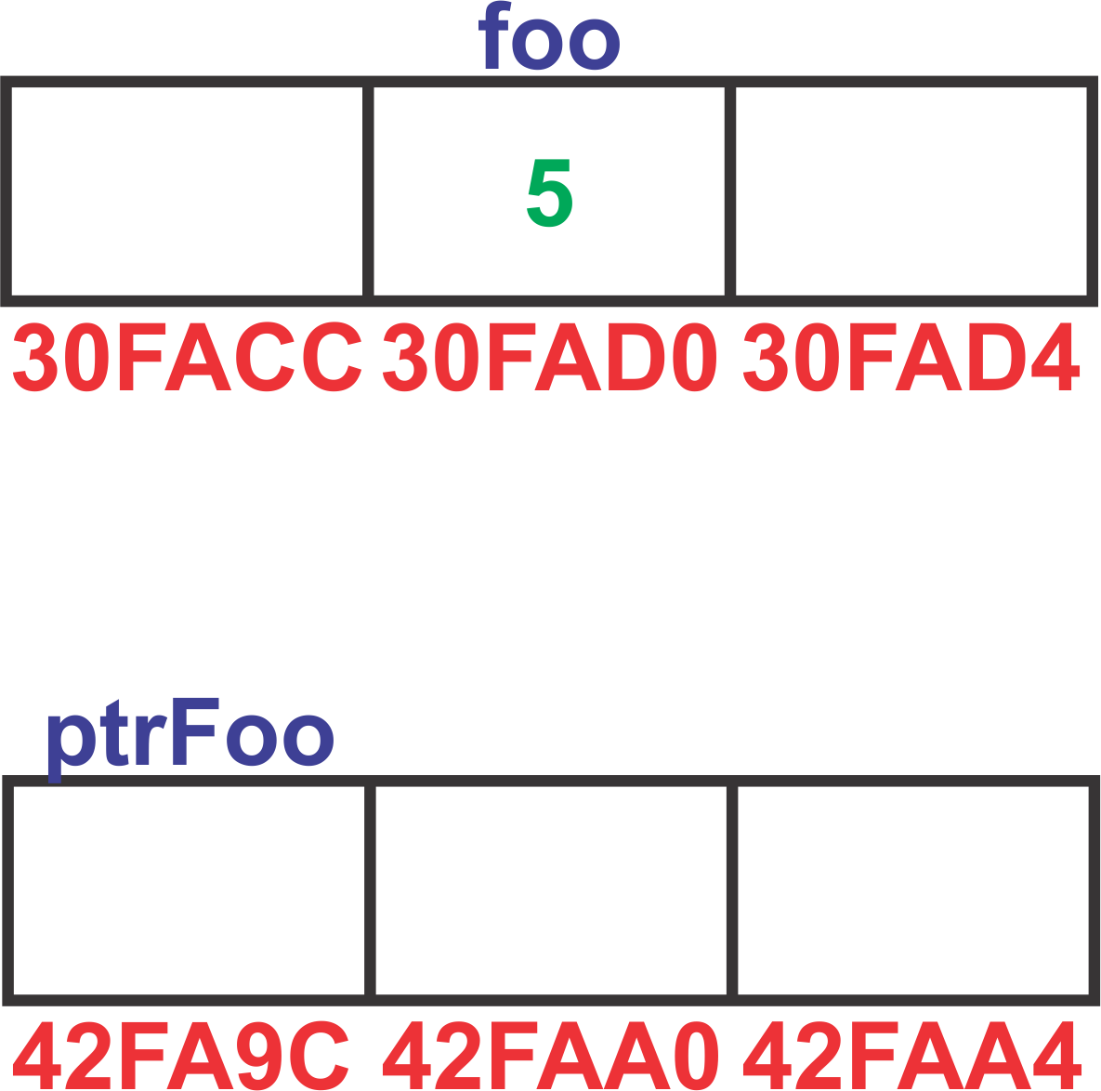
Pointers
Pointer - a variable whose value is the address of another variable
using namespace std;
int main()
{
int foo = 5;
// Declare a pointer to an integer
int *ptrFoo;
// Initialize pointer
ptrFoo = &foo; // store the address of Foo
cout << *ptrFoo; // get value from address: 5
return 0;
}

Slide 13
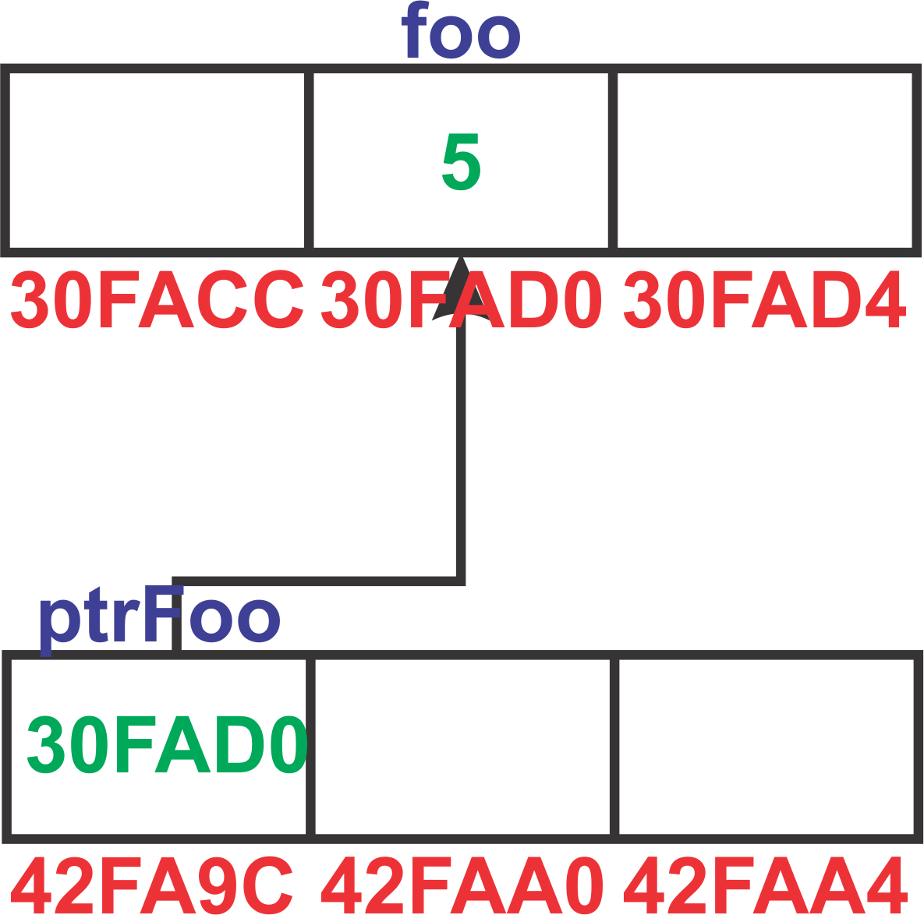
Pointers
Pointer - a variable whose value is the address of another variable
using namespace std;
int main()
{
int foo = 5;
// Declare a pointer to an integer
int *ptrFoo;
// Initialize pointer
ptrFoo = &foo; // store the address of Foo
cout << *ptrFoo; // get value from address: 5
return 0;
}

Slide 14
Pointers
Dereference Operator – returns the value referenced by the pointer
using namespace std;
int main()
{
int foo = 5;
// Declare a pointer to an integer
int *ptrFoo;
// Initialize pointer
ptrFoo = &foo; // store the address of Foo
cout << *ptrFoo; // get value from address: 5
return 0;
}

Slide 15
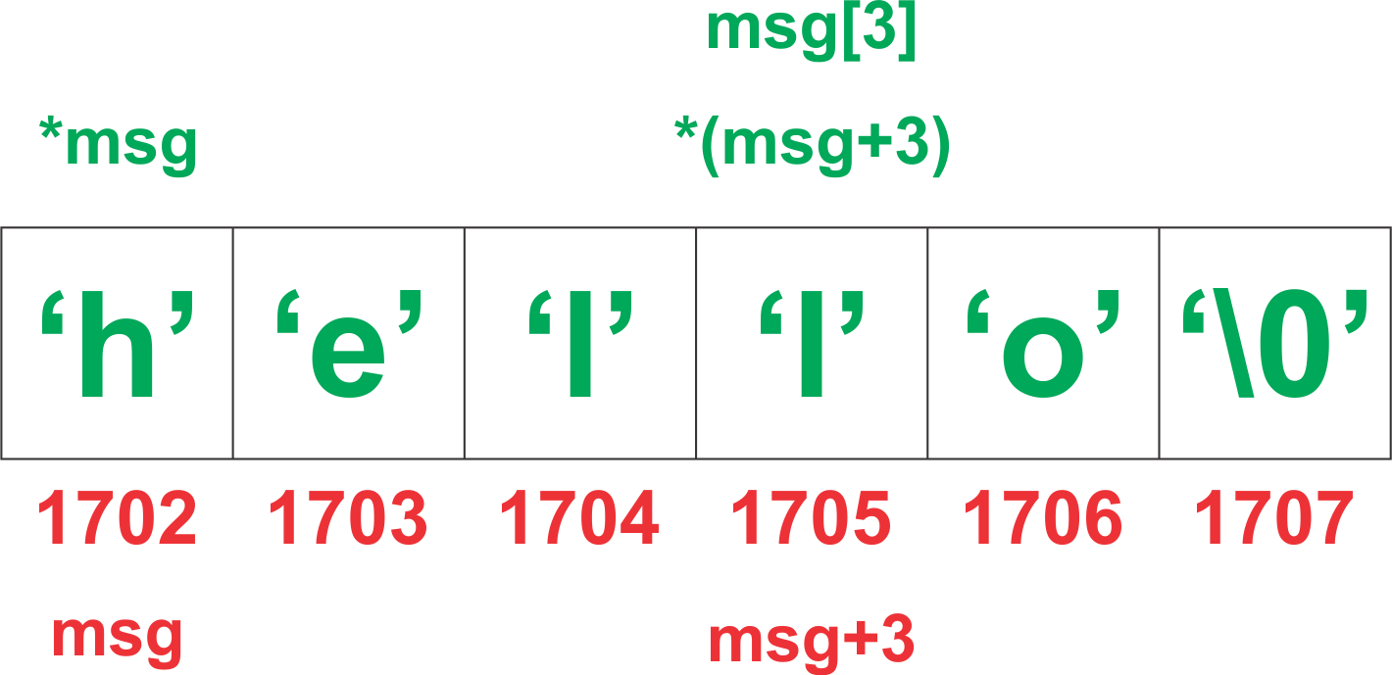
Pointers and arrays
An array is actually a pointer that points to the first element of the array! Because the array variable is a pointer, you can dereference it, which returns array element 0.
.
// declare an array of integer
int myArray[] = { 1, 2, 3, 4, 5 };
// declare and initialize a pointer
int* pMyArray = myArray;
char* msg = "hello";
// cout will pring "h h h"
std::cout << *msg << " "
<< *msg << " "
<< msg[0];

Slide 16
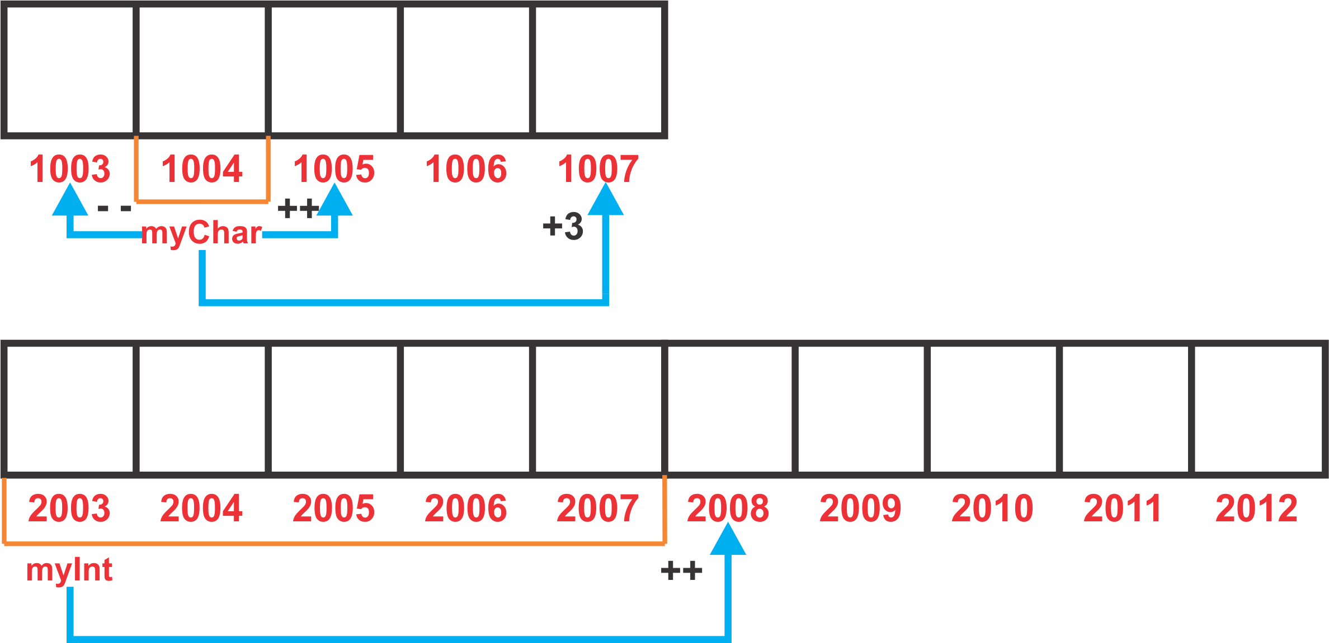
Pointers arithmetic’s
char condition = 'w';
int value = 0;
char *myChar = &condition;
int *myInt = &value;
// ...
switch (condition)
{
case 0: myChar++ ; break;
case 1: myChar--; break;
case 2: myChar+3; break;
default: myInt++;
}

Slide 17
Void pointers
Void, represents the absence of type
They have undetermined length
They have undetermined dereference properties
It can point to any data type
void Print(void* pValue, Type eType)
{
switch (eType)
{
case INT:
std::cout << *static_cast<int*>(pValue) << std::endl;
break;
case FLOAT:
std::cout << *static_cast<float*>(pValue) << std::endl;
break;
case STRING:
std::cout << *static_cast<char*>(pValue) << std::endl;
break;
default:
break;
}
}

Slide 18
Pointers
NULL pointer
A null pointer is a regular pointer that it is not pointing to any valid reference or memory address.
The NULL pointer is a constant with a value of zero defined in several standard libraries, including iostream.
Since C++11 NULL is replaced with nullptr
int main()
{
int* ptr = NULL;
int* newPtr = nullptr;
std::cout << "The first pointer value is " << ptr;
std::cout << "The second pointer value is " << newPtr;
return 0;
}

Slide 19
Dynamic memory in C
Allocate memory:
malloc - Allocates a block of “size” bytes of memory, returning a pointer to the beginning of the block.
calloc - Allocates a block of memory for an array of “num” elements, each of them “size“ bytes long, and initializes all its bits to zero.
realloc - Changes the size of the memory block pointed to by “ptr”.
Deallocate memory:
free - A block of memory previously allocated by a call to malloc, calloc or realloc is deallocated, making it available again for further allocations.

Slide 20
Dynamic memory in C
int main() {
int *pBufferA, *pBufferB, *pBufferC;
// Allocate 400 bytes on the heap.
// It doesn't initializes the values.
pBufferA = (int*) malloc(100 * sizeof(int));
// Prints junk values found in allocated memory.
for (int i = 0; i < 100; i++)
printf("%d ", pBufferA[i]);
// Allocates memory and initializes it with '0'.
pBufferB = (int*) calloc(100, sizeof(int));
for (int i = 0; i < 100; i++)
std::cout << " " << pBufferB[i];
// Allocates the memory used by pBufferB to pBufferC.
pBufferC = (int*) realloc(pBufferB, 500 * sizeof(int));
// Dealocate memory
free(pBufferA);
free(pBufferC);
return 0;
}

Slide 21
Dynamic memory in C++
Allocate memory
new – Allocates “size” bytes of storage, suitably aligned to represent any object of that size, and returns a non-null pointer to the first byte of this block – single object form.
new[] – multiple object form (for arrays)
Deallocate memory:
delete Default deallocation functions -single-object form.
delete[] - multiple object form (for arrays)
Single object form
// Dynamically allocated integer
int *pValue = new int;
// Assign value to this integer
*pValue = 7;
// Unallocate memory occupied by pValue
delete pValue;
pValue = nullptr;
Multiple object form
int nSize = 12;
// Dynamically allocated array
int *pMyArray = new int[nSize];
// Assign value to the 5th array element
pMyArray[4] = 7;
// Free the resources used by the array
delete[] pMyArray;
pMyArray = nullptr;
Memory leak
void doMemoryLeak()
{
int *pValue = new int;
// allocated resources are not freed
// when variable goes out of scope
// ...
// Next line would fix the memory leak:
// delete pValue;
}

Slide 22
References
http://en.cppreference.com
http://www.cplusplus.com
http://www.learncpp.com
Video tutorial:
From C++ Tutorial for Beginners 29 – Classes: The Foundation of Object-Oriented Programming
To C++ Tutorial for Beginners 35 – The “this” keyword, A first taste of pointers

Slide 23
Contact
Published by Siemens 2023
Ionuț Verzea
Software Engineer ADV D EU RO IFA MI
Blv. 15 Noiembrie Nr.78 500097 Brașov România
E-mail ionut.verzea@siemens.com

